Slide 1
Digital Modulation
Prepared by
Prof. Hitesh Dholakiya
Modified by
Rifat Rahman
Assistant Professor
Institute of Appropriate Technology, BUET
https://rrahman007.buet.ac.bd

Slide 2
Amplitude Shift Keying - ASK
Outlines
Basics of ASK
Waveforms of ASK
Bandwidth of ASK
Demodulation of ASK
Constellation Diagram of ASK
Advantages of ASK
Disadvantages of ASK
Applications of ASK

Slide 3
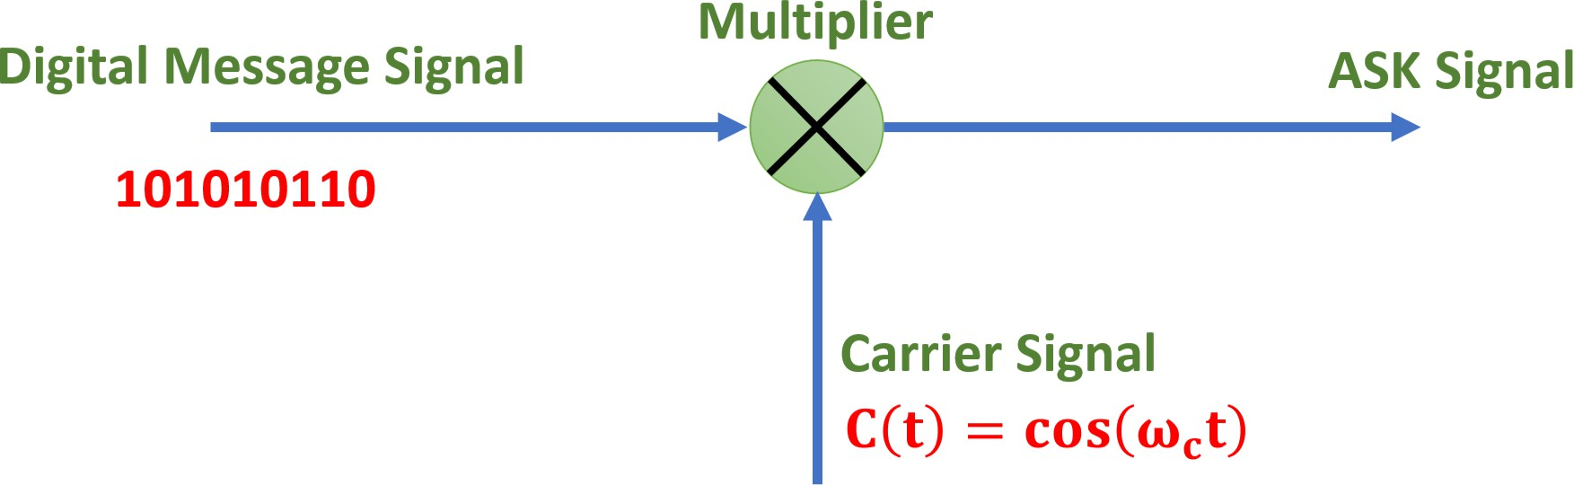
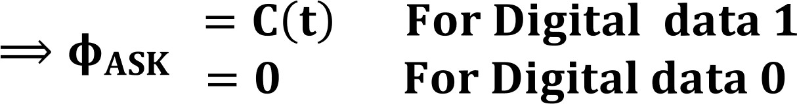
Basics of ASK
ASK is a digital modulation technique that converts digital signals into Analog form by varying the carrier’s amplitude, enabling efficient transmission over a communication channel.
In ASK, the Amplitude of the Carrier Signal varies according to the Digital Message Signal.
{BASK or OOK} ASK Signal is given by:

Slide 4
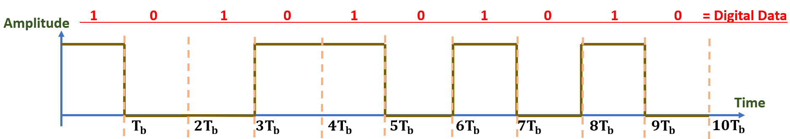
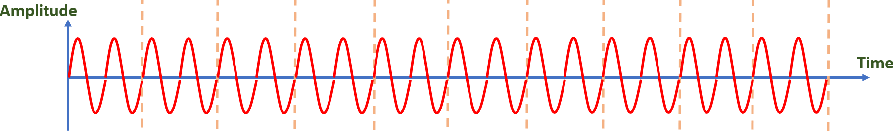
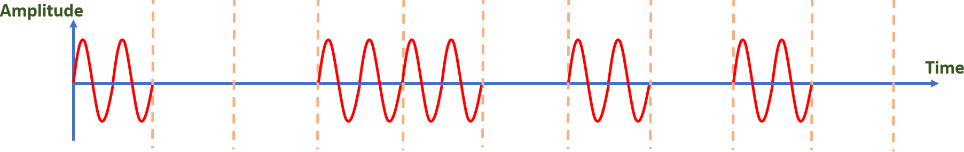
Waveforms of ASK
0
1
Carrier Signal
ASK Signal

Slide 5
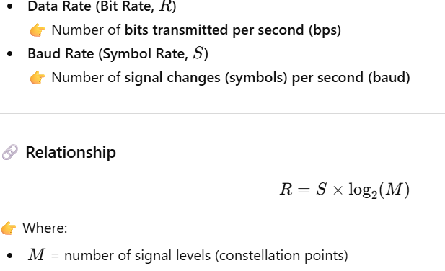
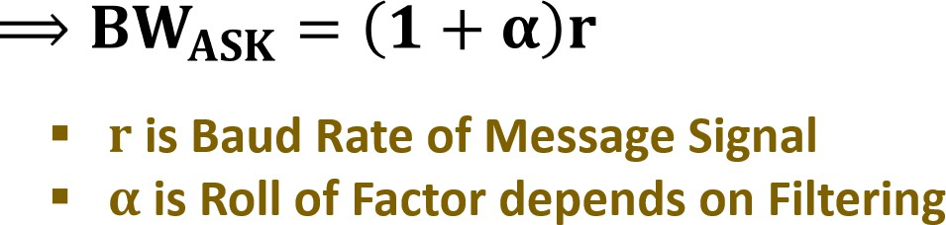
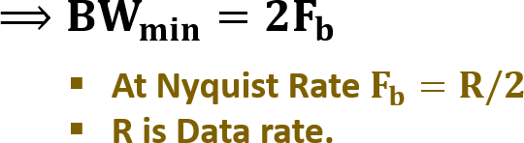
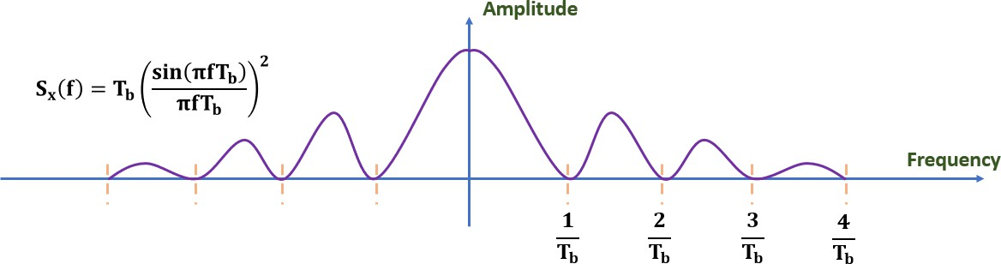
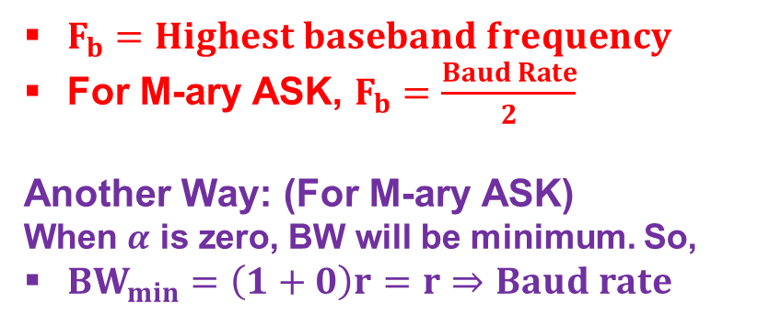
Bandwidth of ASK
Ideally, its bandwidth equals the Baud rate of the message, but in practice, it is slightly
greater.
(For Binary ASK)
$F_{b}=Highest baseband frequency$
For M-ary ASK, $F_{b}=\frac{Baud Rate}{2}$
Another Way: (For M-ary ASK)
When $α$ is zero, BW will be minimum. So,
$BW_{min}=\left(1+0\right)r=r⇒Baud rate$

Slide 6
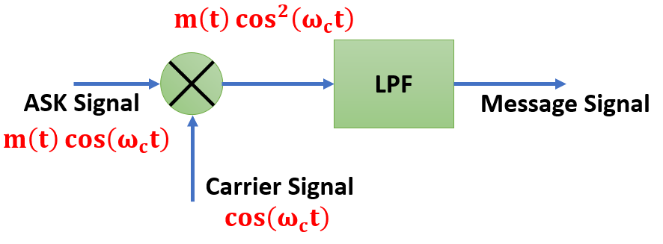





Demodulation of ASK
There are two Types of ASK Demodulation:
Synchronous (Coherent)
Asynchronous (Non-Coherent)
Synchronous (Coherent) ASK Demodulation
Asynchronous (Non-Coherent) ASK Demodulation
Rectifier
LPF
Comparator
LPF
ASK Signal Message Signal
Carrier Signal
ASK
Signal
Message
Signal
Pro: Efficient Method.
Con: Need of Oscillator for Carrier.
Pro: No Need of Oscillator for Carrier.
Con: Poor Performance (Less SNR)

Slide 7




Constellation Diagram of ASK
A constellation diagram is a graphical representation of a digital signal showing how data symbols are mapped onto signal states. 𝐼(𝑡) → In-phase component and 𝑄(𝑡) → Quadrature component (90° phase shifted)
Q(t)
Q(t)
Bipolar 4-ASK
I(t)
00
01
10
11
I(t)
Symbol for Logic 0
Symbol for Logic 1
Binary ASK
4-ASK

Slide 8
Advantages of ASK
Simple Implementation (Easy Modulation and Demodulation)
Band Efficient
Useful for Low Cost Applications
Disadvantages of ASK
Highly Sensitive to Noise
Bad Performance in Wireless Communication
Applications of ASK
Optical Fiber Communication
Low Frequency RF Communication {RFID Tag}
In Early Modems
IR Remote Control

Slide 9


Signal Space Diagram of ASK
Signal Space Diagram explains the distance between digital symbols.
𝐂 𝐭
= 𝐀' 𝐜𝐨𝐬 (𝛚_{𝐜}𝐭)

Slide 10
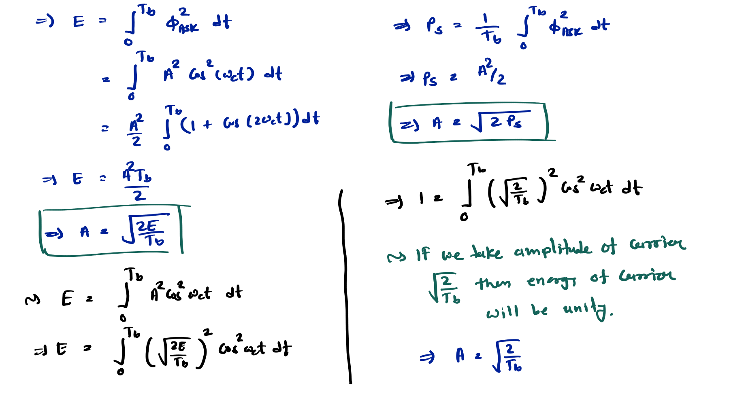

Slide 11
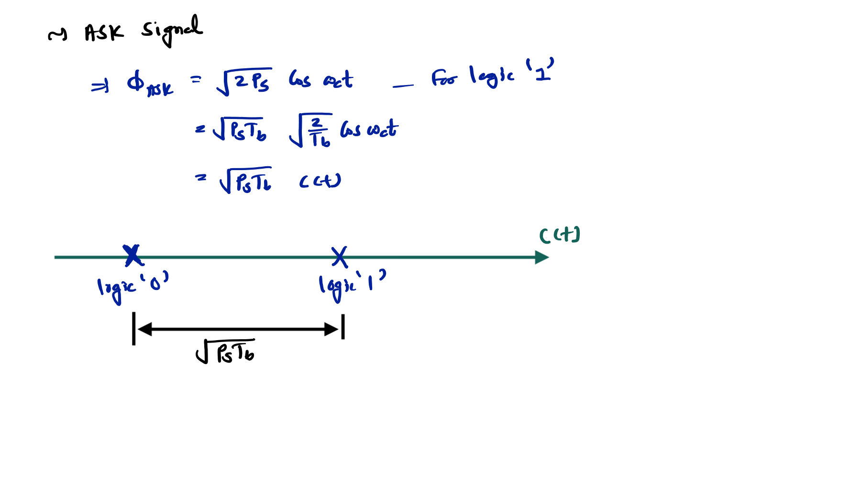

Slide 12
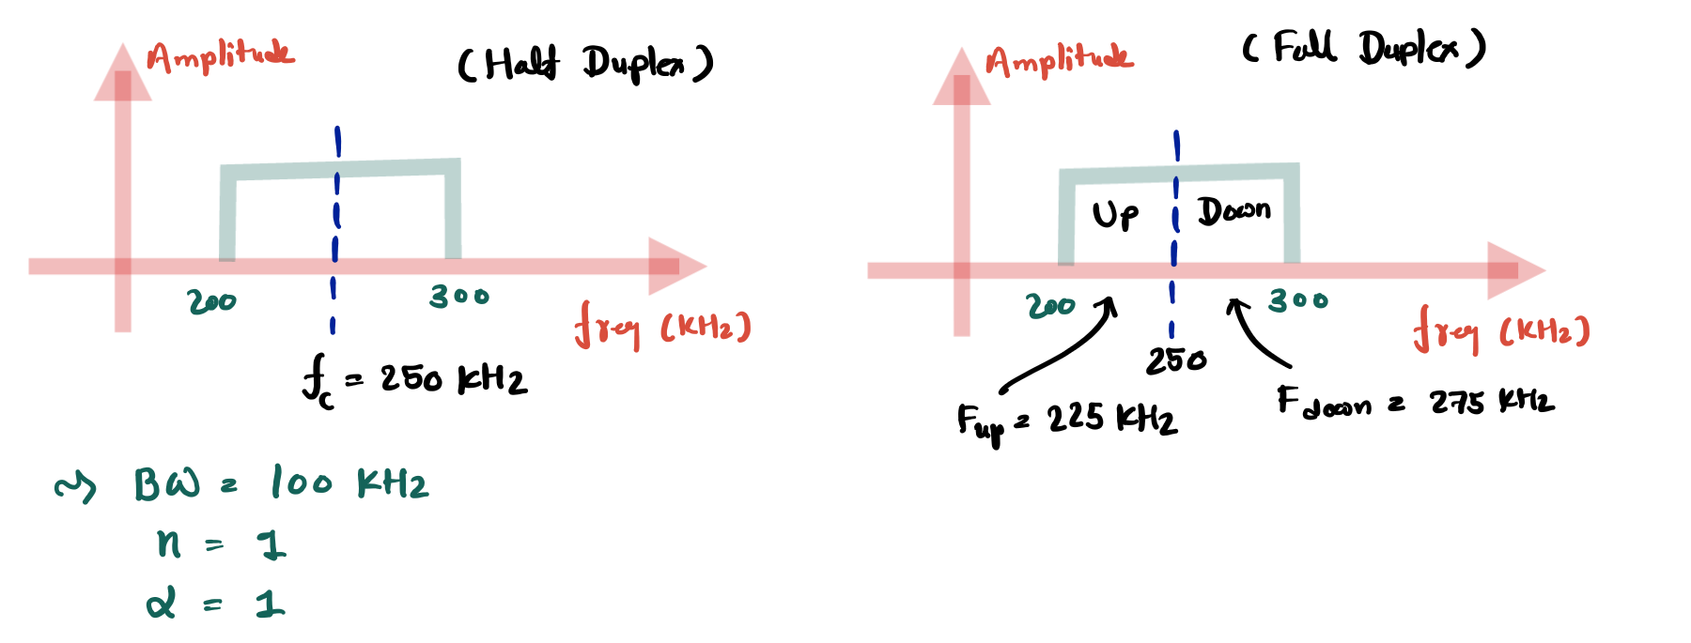
Example of ASK
1. Example: We have an available bandwidth of 100 kHz, ranging from 200 kHz to 300 kHz. If we modulate our data using BASK with a roll-off factor of 1, what are the carrier frequency and bit rate?

Slide 13
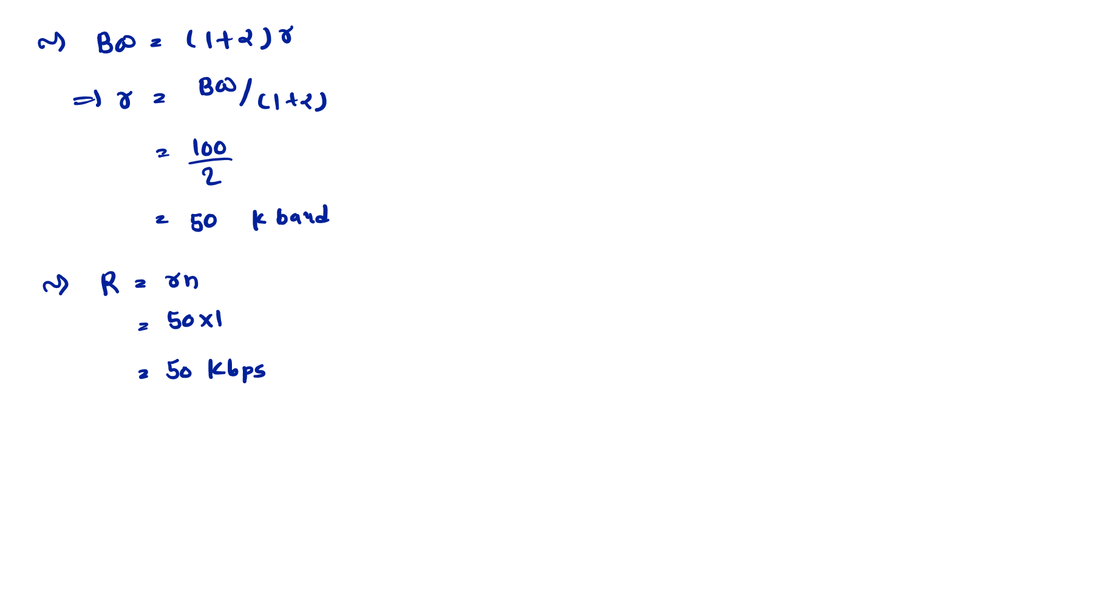

Slide 14
Frequency Shift Keying - FSK
Outlines
Basics of FSK
Waveforms of FSK
Bandwidth of FSK
Multilevel FSK
Demodulation of FSK
Constellation Diagram of FSK
Advantages of FSK
Disadvantages of FSK
Applications of FSK

Slide 15
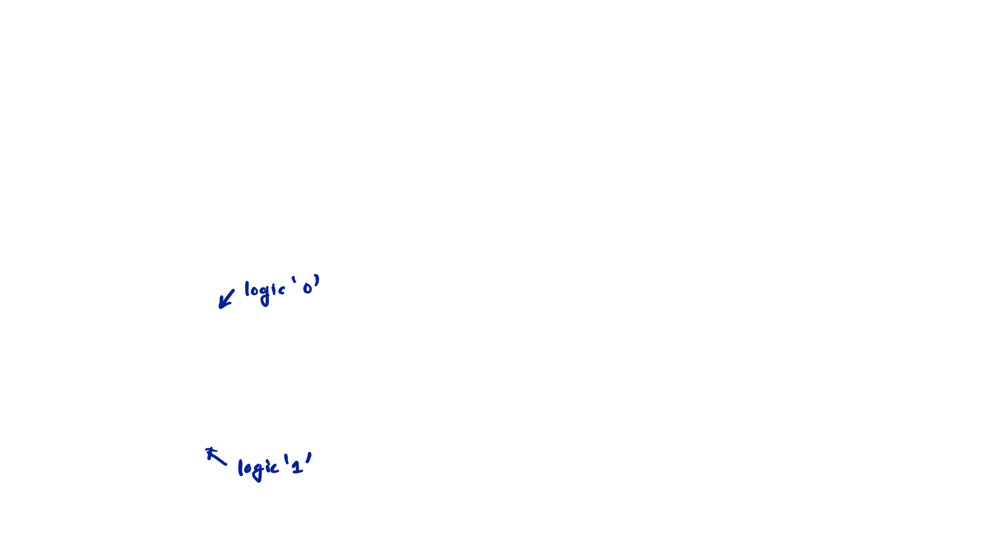
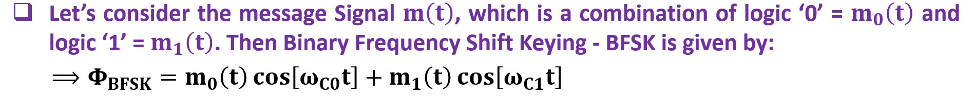
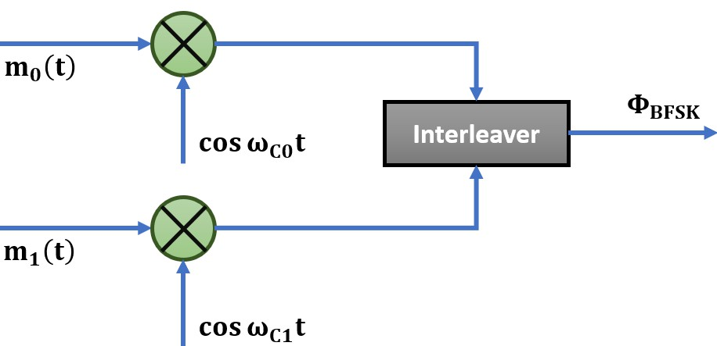





Basics of FSK
FSK is a digital modulation technique that converts digital signals into Analog form by varying the carrier’s frequency, enabling efficient transmission over a communication channel.
In FSK, the Frequency of the Carrier Signal varies according to the Digital Message Signal.
❑ Let’s consider the message Signal 𝐦 𝐭 , which is a combination of logic ‘0’ = 𝐦_{𝟎} 𝐭 and
logic ‘1’ = 𝐦_{𝟏} 𝐭 . Then Binary Frequency Shift Keying - BFSK is given by:
⟹ 𝚽_{𝐁𝐅𝐒𝐊} = 𝐦_{𝟎} 𝐭 𝐜𝐨𝐬 𝛚_{𝐂𝟎}𝐭 + 𝐦_{𝟏} 𝐭 𝐜𝐨𝐬 𝛚_{𝐂𝟏}𝐭
𝐦_{𝟎} 𝐭
^{𝚽}𝐁𝐅𝐒𝐊
_{𝐜𝐨𝐬 𝛚𝐂𝟎𝐭} Interleaver
𝐦_{𝟏} 𝐭
𝐜𝐨𝐬 𝛚_{𝐂𝟏}𝐭

Slide 16
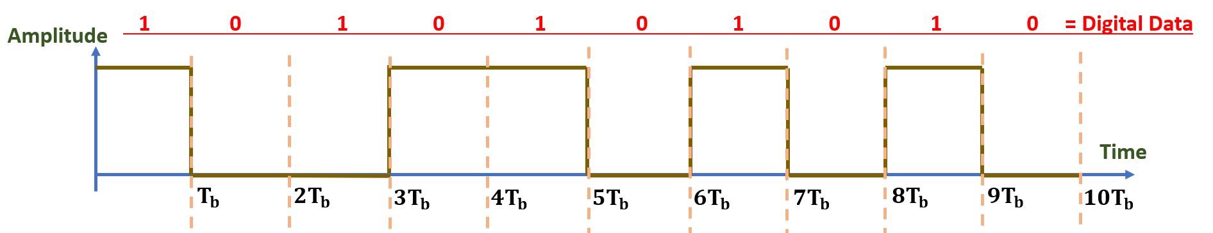
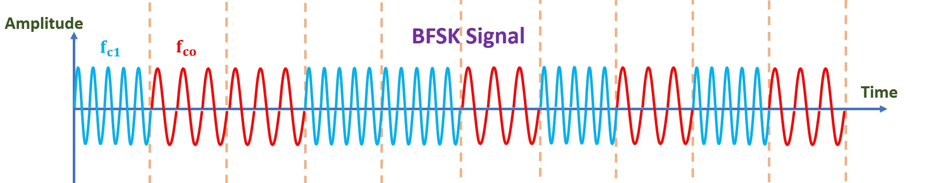
Waveforms of FSK

Slide 17
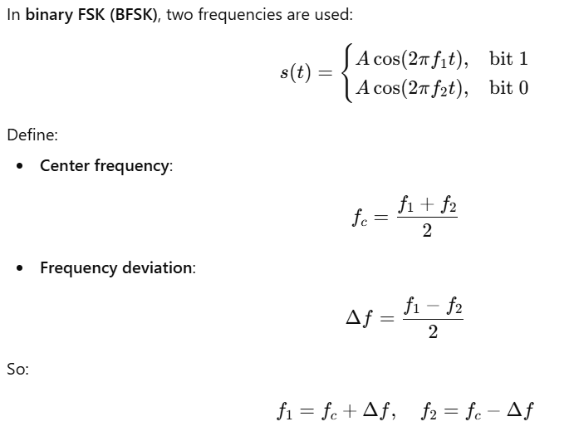
BFSK Signal Basics
$$2Δf=Frequency Separation$$

Slide 18
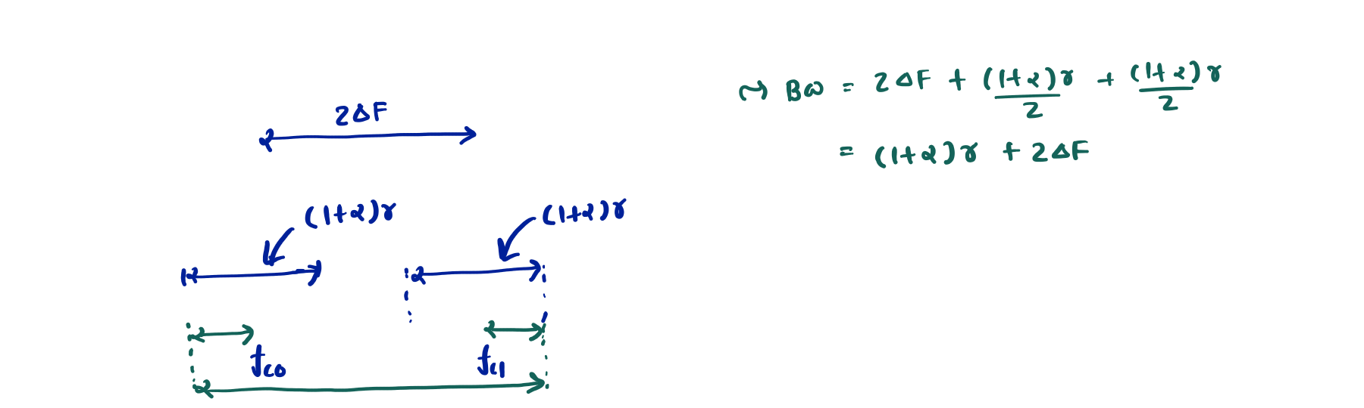
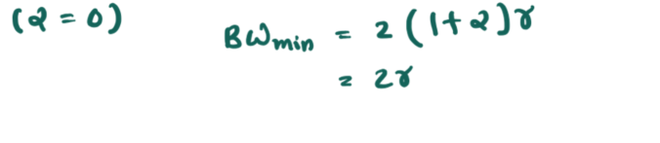
Bandwidth of BFSK
Amplitude
Frequency
Minimum Bandwidth of BFSK
Amplitude
Frequency

Slide 19
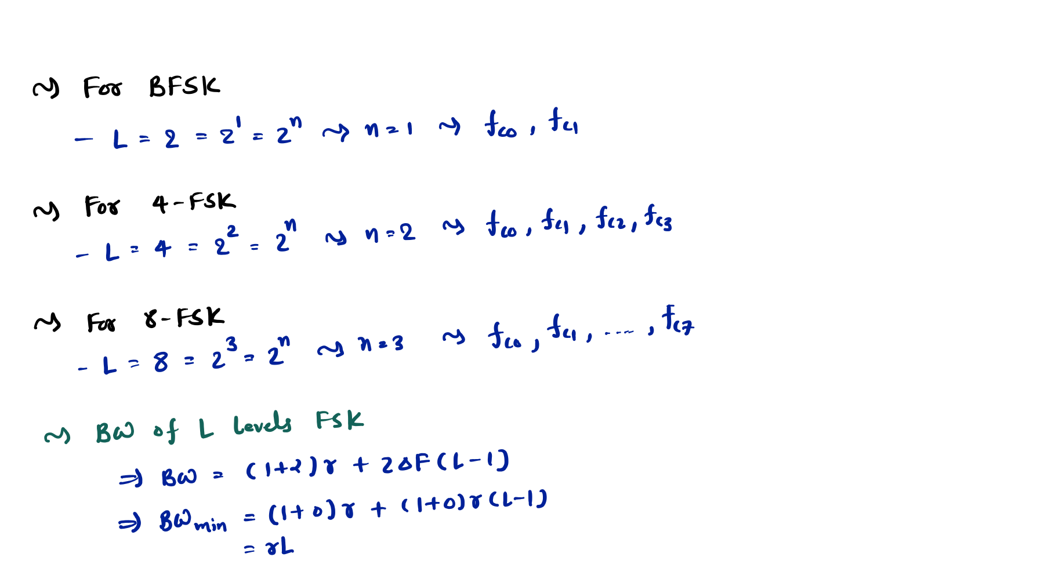
Multi-Level FSK
Number of Level=Number of Symbol =M
M
M
M
M
M
M
M

Slide 20
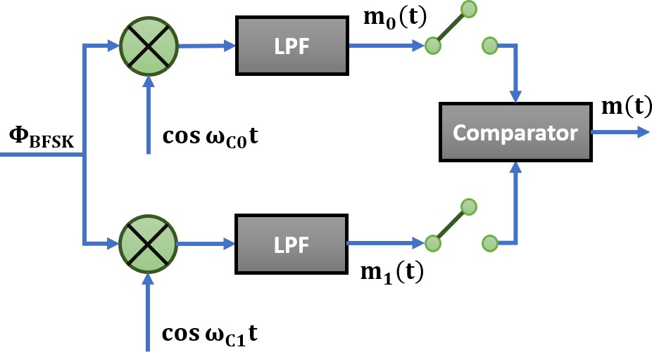
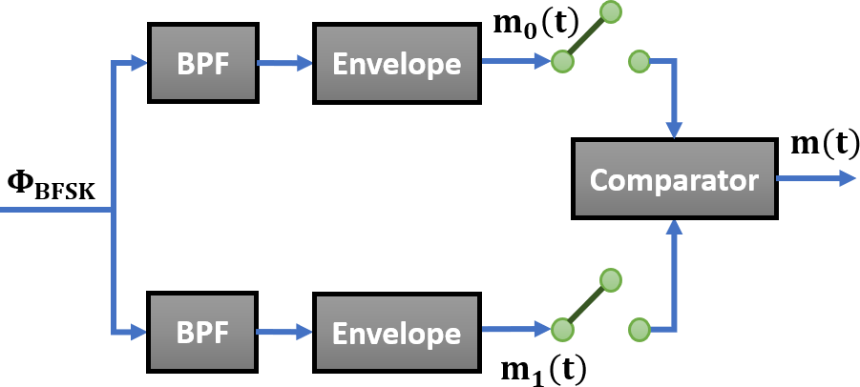
FSK Demodulation
Synchronous (Coherent) FSK Demodulation
Asynchronous (Non-Coherent) FSK Demodulation
Pro: Efficient Method.
Con: Need of Oscillator for Carrier.
Pro: No Need of Oscillator for Carrier.
Con: Poor Performance (Less SNR)

Slide 21



Constellation Diagram of FSK
For BFSK
Frequency Axis
Symbol for Logic 0
Symbol for Logic 1
For 4-FSK
Frequency Axis
00
01
10
11

Slide 22
Advantages of FSK
Simple Implementation (Easy Modulation and Demodulation)
Better Noise Immunity compared to ASK
Reliable for low Data Rate Applications
Disadvantages of FSK
Required Large Bandwidth compared to ASK and PSK
Coherent Detection more complex
Not good for high Data Rate Transmission
Applications of FSK
In Early Modems
Low Frequency Wireless Systems
Bluetooth (GFSK)
Paging Systems

Slide 23
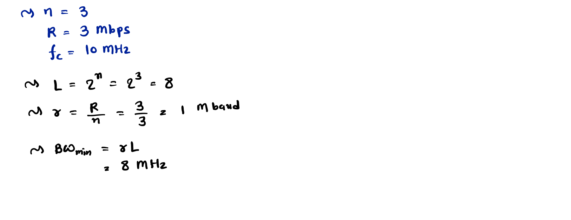
Examples of FSK
1. Example: We transmit data 3 bits at a time at a bit rate of 3 Mbps. The carrier frequency is 10 MHz. Calculate (a) the number of levels, (b) the baud rate, and (c) the minimum bandwidth for FSK.
M
M

Slide 24
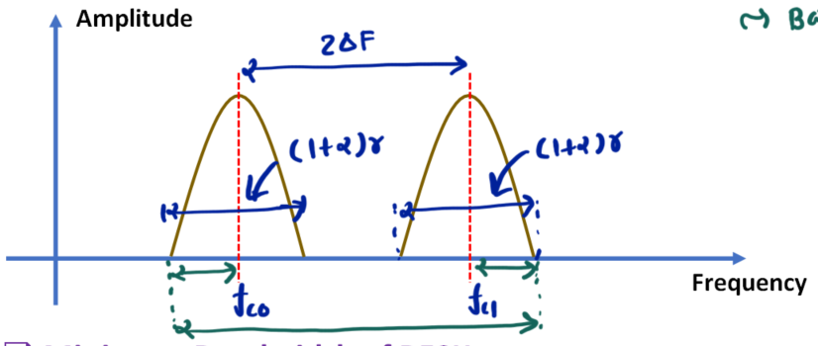
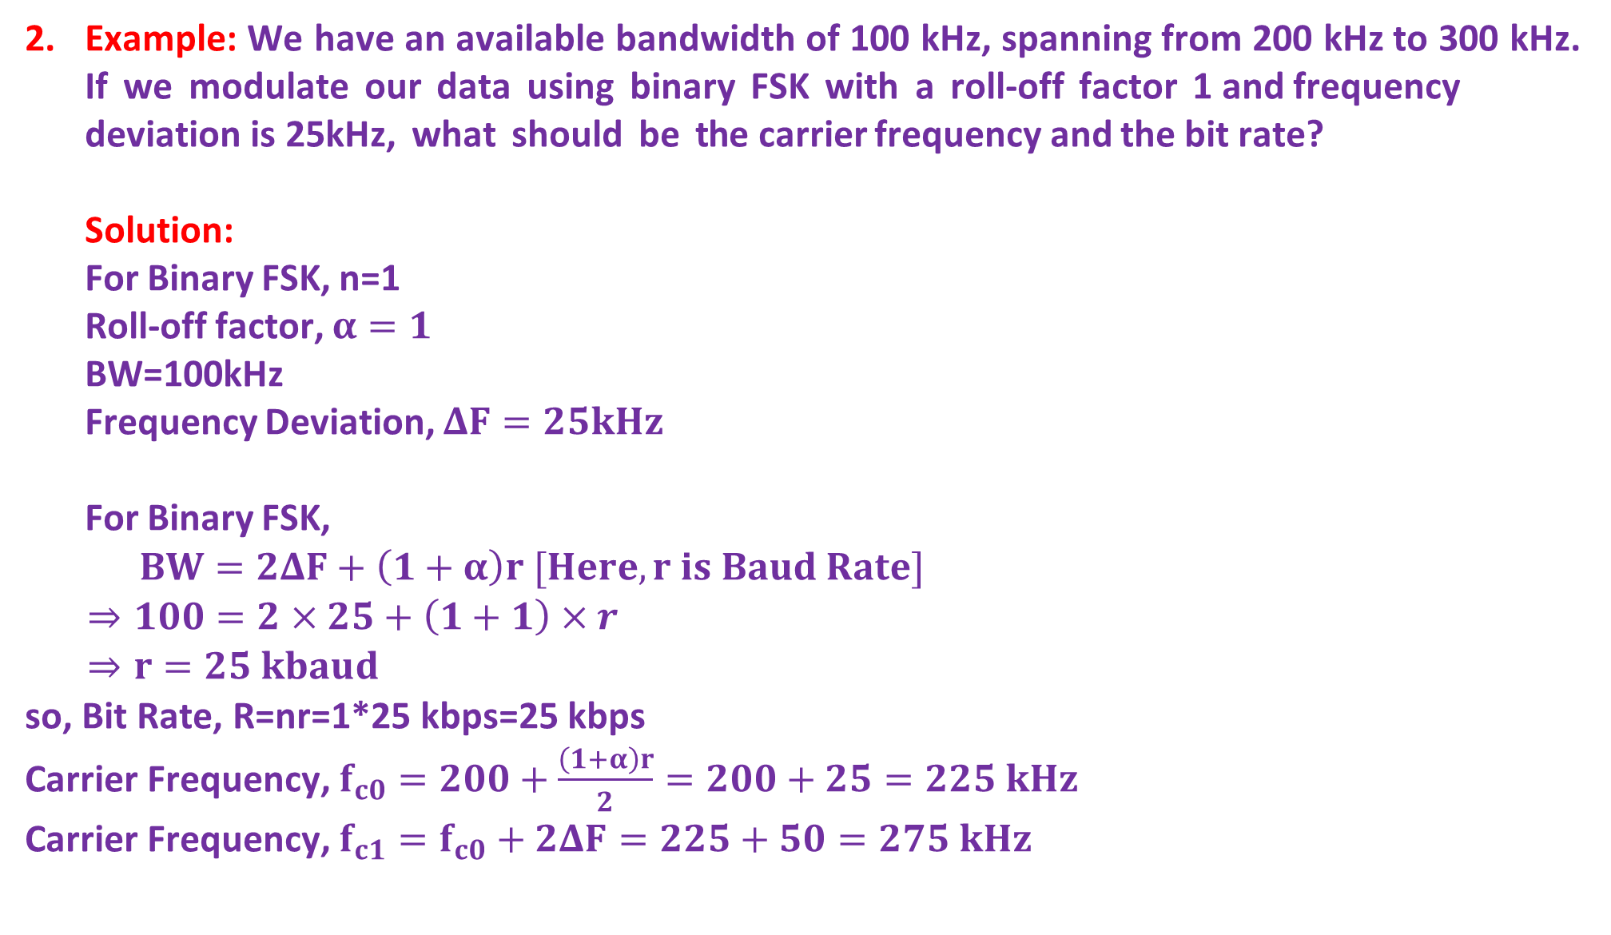
Example: We have an available bandwidth of 100 kHz, spanning from 200 kHz to 300 kHz. If we modulate our data using binary FSK with a roll-off factor 1 and frequency deviation is 25kHz, what should be the carrier frequency and the bit rate? Solution: For Binary FSK, n=1 Roll-off factor, $α=1$ BW=100kHz Frequency Deviation, $ΔF=25kHz$ For Binary FSK,
$BW=2ΔF+\left(1+α\right)r [Here, r is Baud Rate]$
$⇒100=2×25+\left(1+1\right)×r$
$⇒r=25 kbaud$
so, Bit Rate, R=nr=1*25 kbps=25 kbps
Carrier Frequency, $f_{c0}=200+\frac{\left(1+α\right)r}{2}=200+25=225 kHz$
Carrier Frequency, $f_{c1}=f_{c0}+2ΔF=225+50=275 kHz$

Slide 25
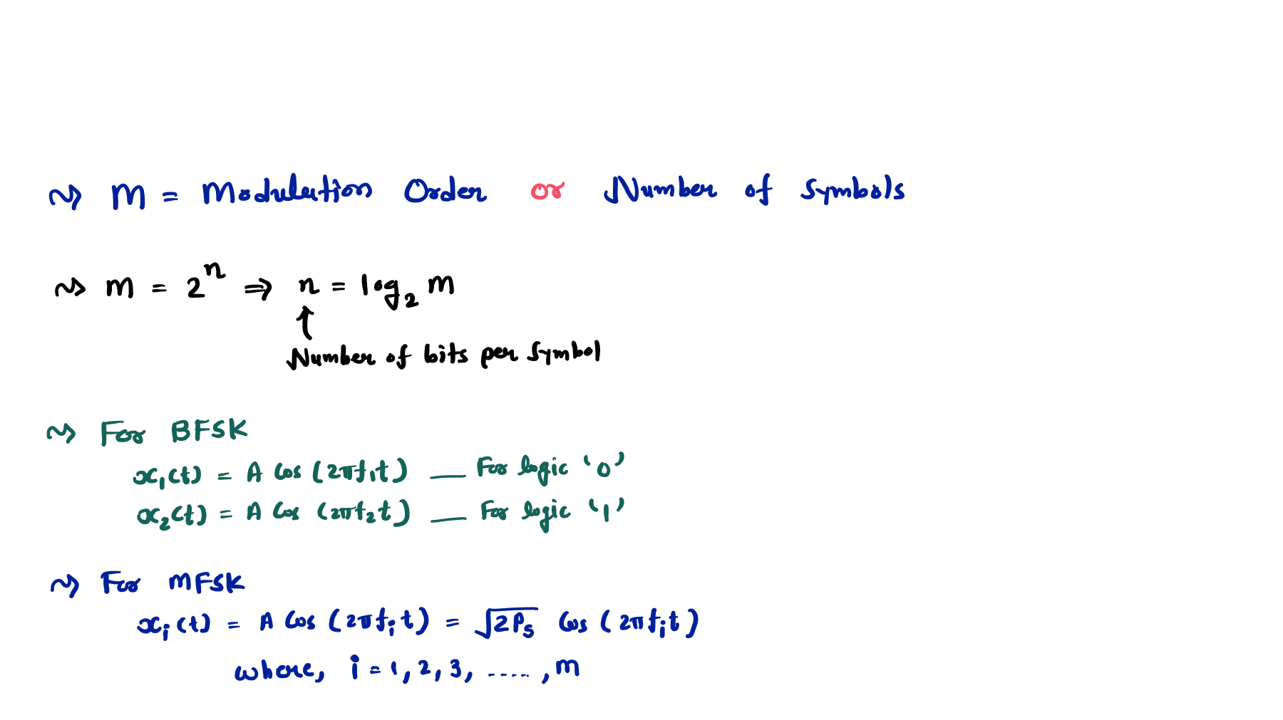
M-ary FSK - MFSK
Basics and Equation of MFSK

Slide 26
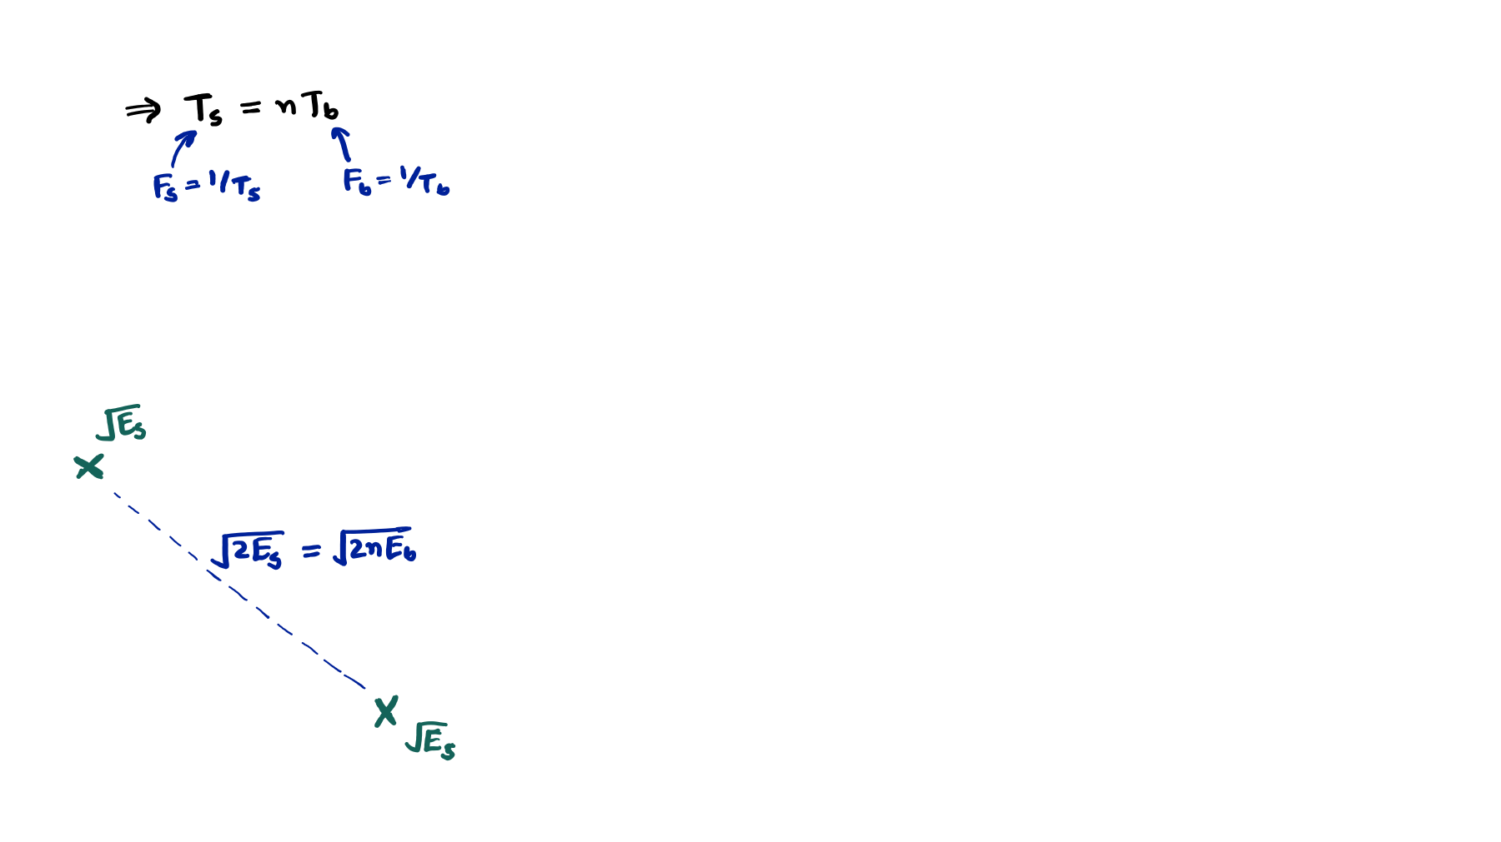
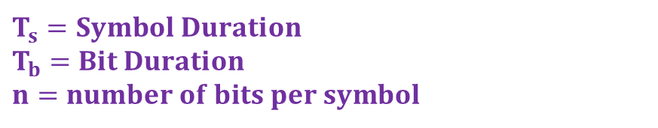
Symbol Duration of MFSK
$$T_{s}=Symbol Duration$$
$$T_{b}=Bit Duration$$
$$n=number of bits per symbol$$
Spacing between symbols in MFSK
Carrier signal with 𝐟_{𝟐}
Carrier signal with 𝐟_{𝟏}

Slide 27
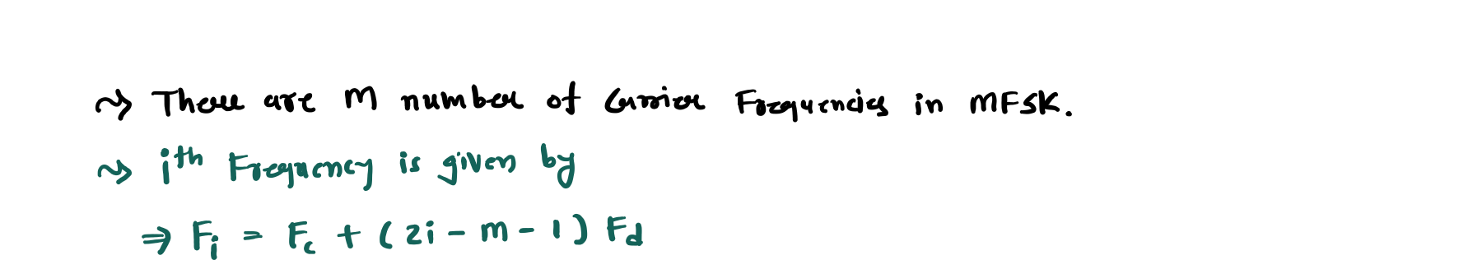
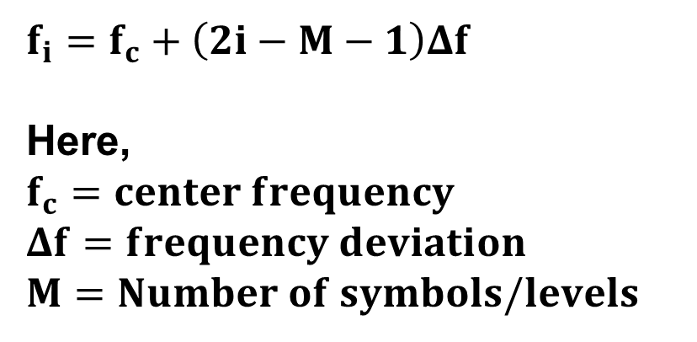
Frequencies of MFSK
$$f_{i}=f_{c}+\left(2i−M−1\right)Δf$$
Here,
$$f_{c}=center frequency$$
$$Δf=frequency deviation$$
$$M=Number of symbols/levels$$

Slide 28
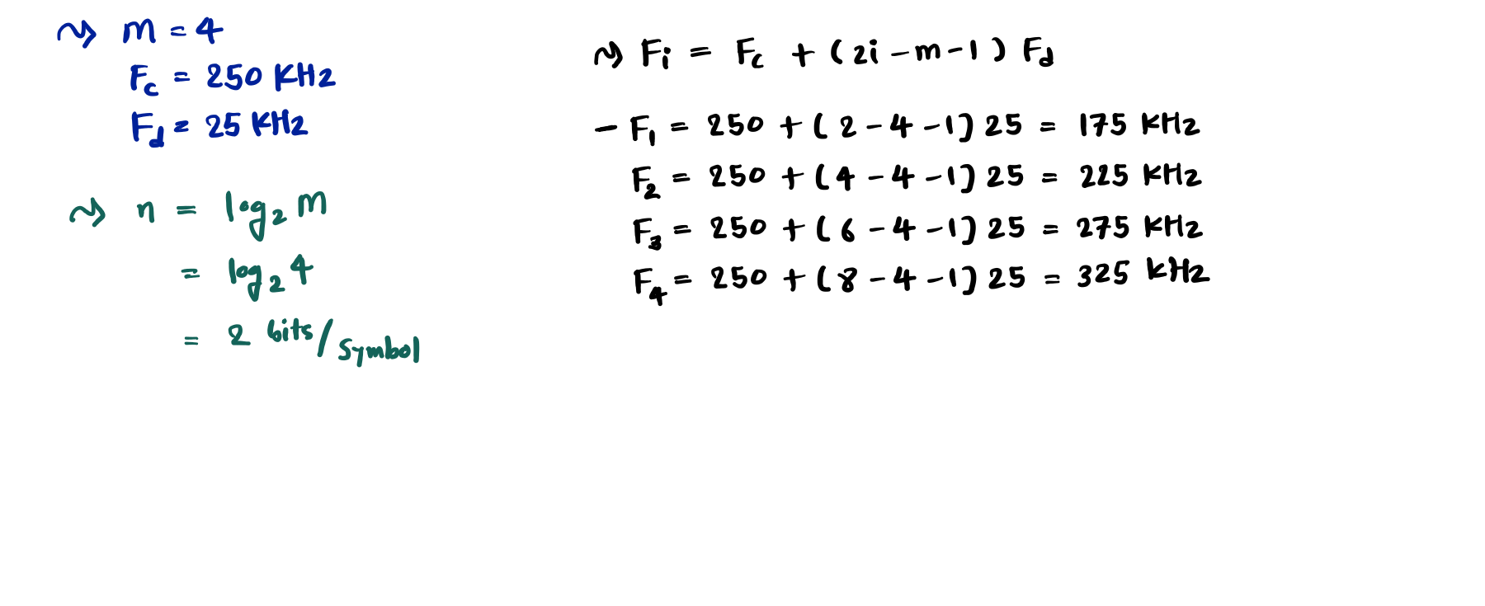
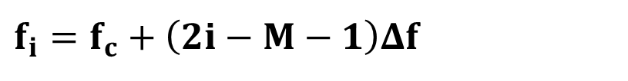
Example of MFSK
For a 4-FSK system, the center frequency is 250 kHz and the frequency deviation is 25 kHz. Determine (a) the number of bits per symbol, and (b) the individual carrier frequencies used.
$$f_{i}=f_{c}+\left(2i−M−1\right)Δf$$

Slide 29
Phase Shift Keying - PSK
Outlines
Basics of PSK
Waveforms of BPSK
Bandwidth of PSK
Multilevel PSK
Demodulation of PSK
Constellation Diagram of PSK
Advantages of PSK
Disadvantages of PSK
Applications of PSK

Slide 30
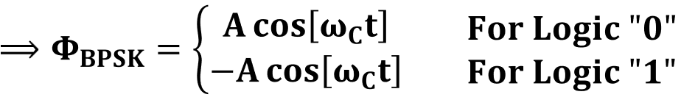
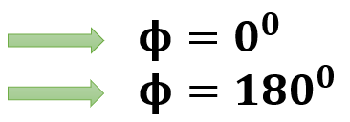




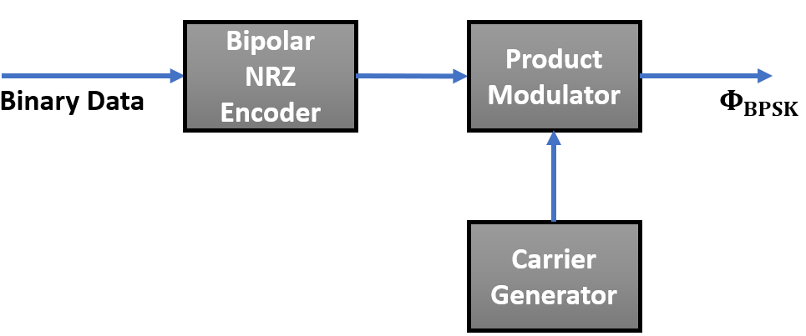

Basics of PSK
PSK is a digital modulation technique that converts digital signals into Analog form by varying the carrier’s Phase, enabling efficient transmission over a communication channel.
In PSK, the Phase of the Carrier Signal varies according to the Digital Message Signal.
Let’s consider Binary PSK, the Binary message Signal m(t), which is a combination of logic
‘0’= -1 and logic ‘1’= +1.
𝐀 𝐜𝐨𝐬 𝛚𝐂𝐭 𝐅𝐨𝐫 𝐋𝐨𝐠𝐢𝐜 "𝟎"
^{⟹ 𝚽𝐁𝐏𝐒𝐊 = ቊ}−𝐀 𝐜𝐨𝐬 𝛚 𝐭 𝐅𝐨𝐫 𝐋𝐨𝐠𝐢𝐜 "𝟏"
𝐂
𝛟 = 𝟎^{𝟎}
𝛟 = 𝟏𝟖𝟎^{𝟎}
Bipolar
_{NRZ} Product
Binary Data _{Encoder} ^{Modulator} 𝚽_{𝐁𝐏𝐒𝐊}
Carrier
Generator

Slide 31
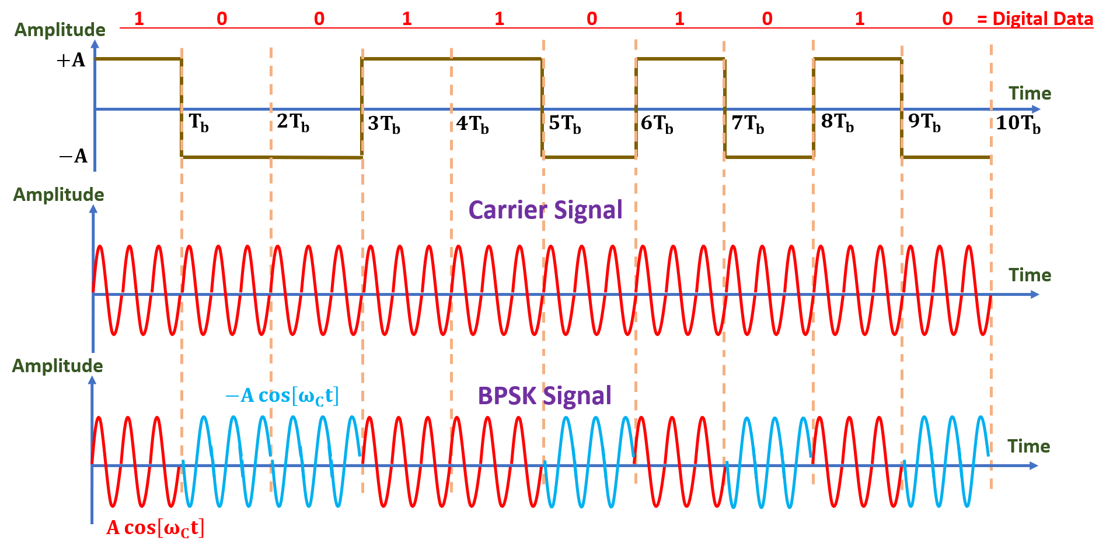
Waveforms of PSK

Slide 32
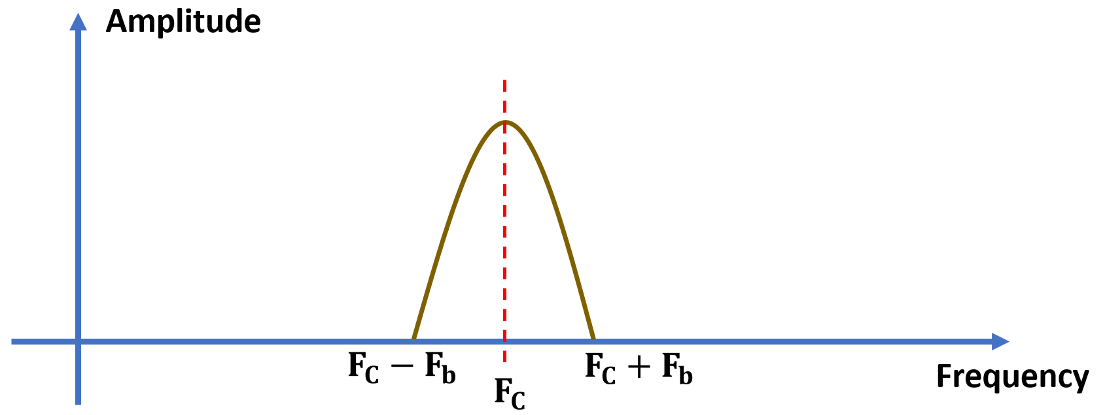
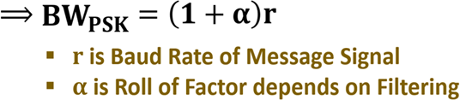
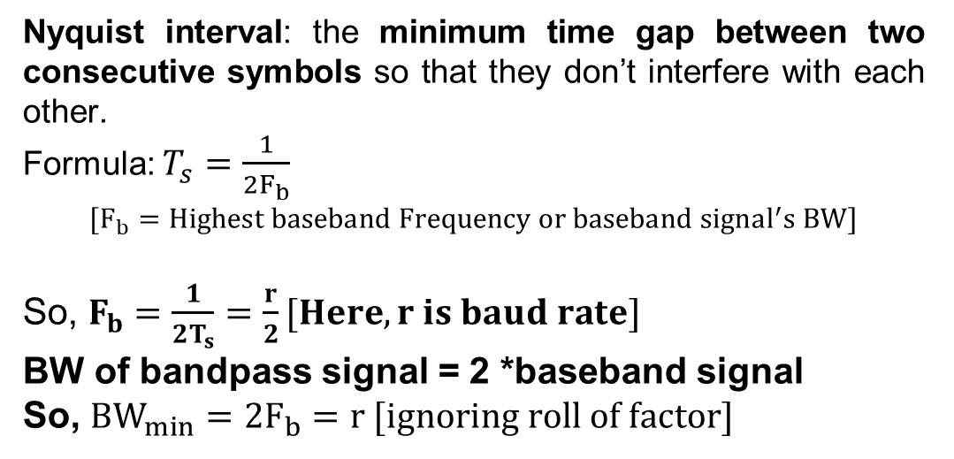
Bandwidth of PSK
Amplitude
𝐅_{𝐂} − 𝐅_{𝐛} 𝐅_{𝐂} + 𝐅_{𝐛}
_{𝐅𝐂} Frequency
Nyquist interval: the minimum time gap between two consecutive symbols so that they don’t interfere with each other.
Formula: $T_{s}=\frac{1}{2F_{b}}$
$$[F_{b}=Highest baseband Frequency or baseband signal^{′}s BW]$$
So, $F_{b}=\frac{1}{2T_{s}}=\frac{r}{2}[Here, r is baud rate]$
BW of bandpass signal = 2 *baseband signal
So, $BW_{min}=2F_{b}=r [ignoring roll of factor]$
$BW_{min}=\left(1+0\right)r=r [as α=0 during BW_{min}$]

Slide 33
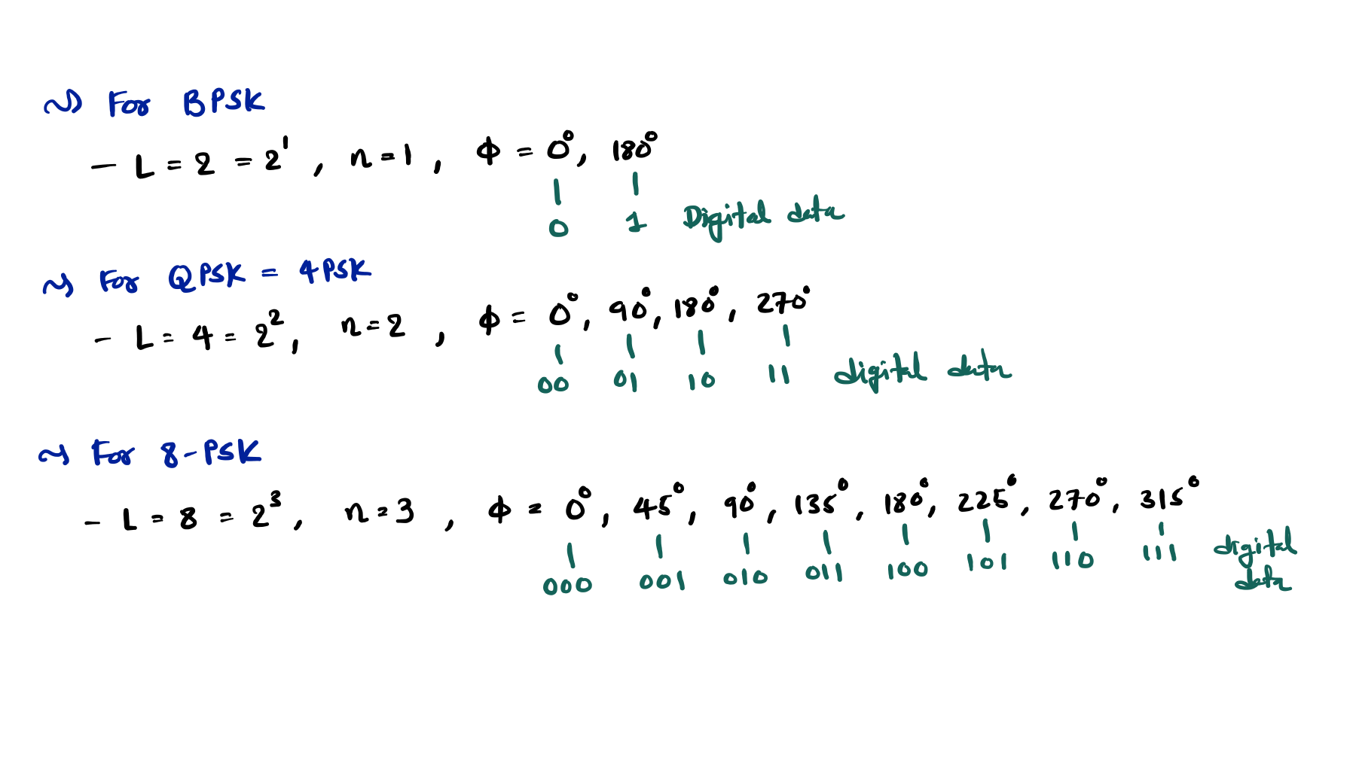
Multilevel PSK
M
M
M

Slide 34
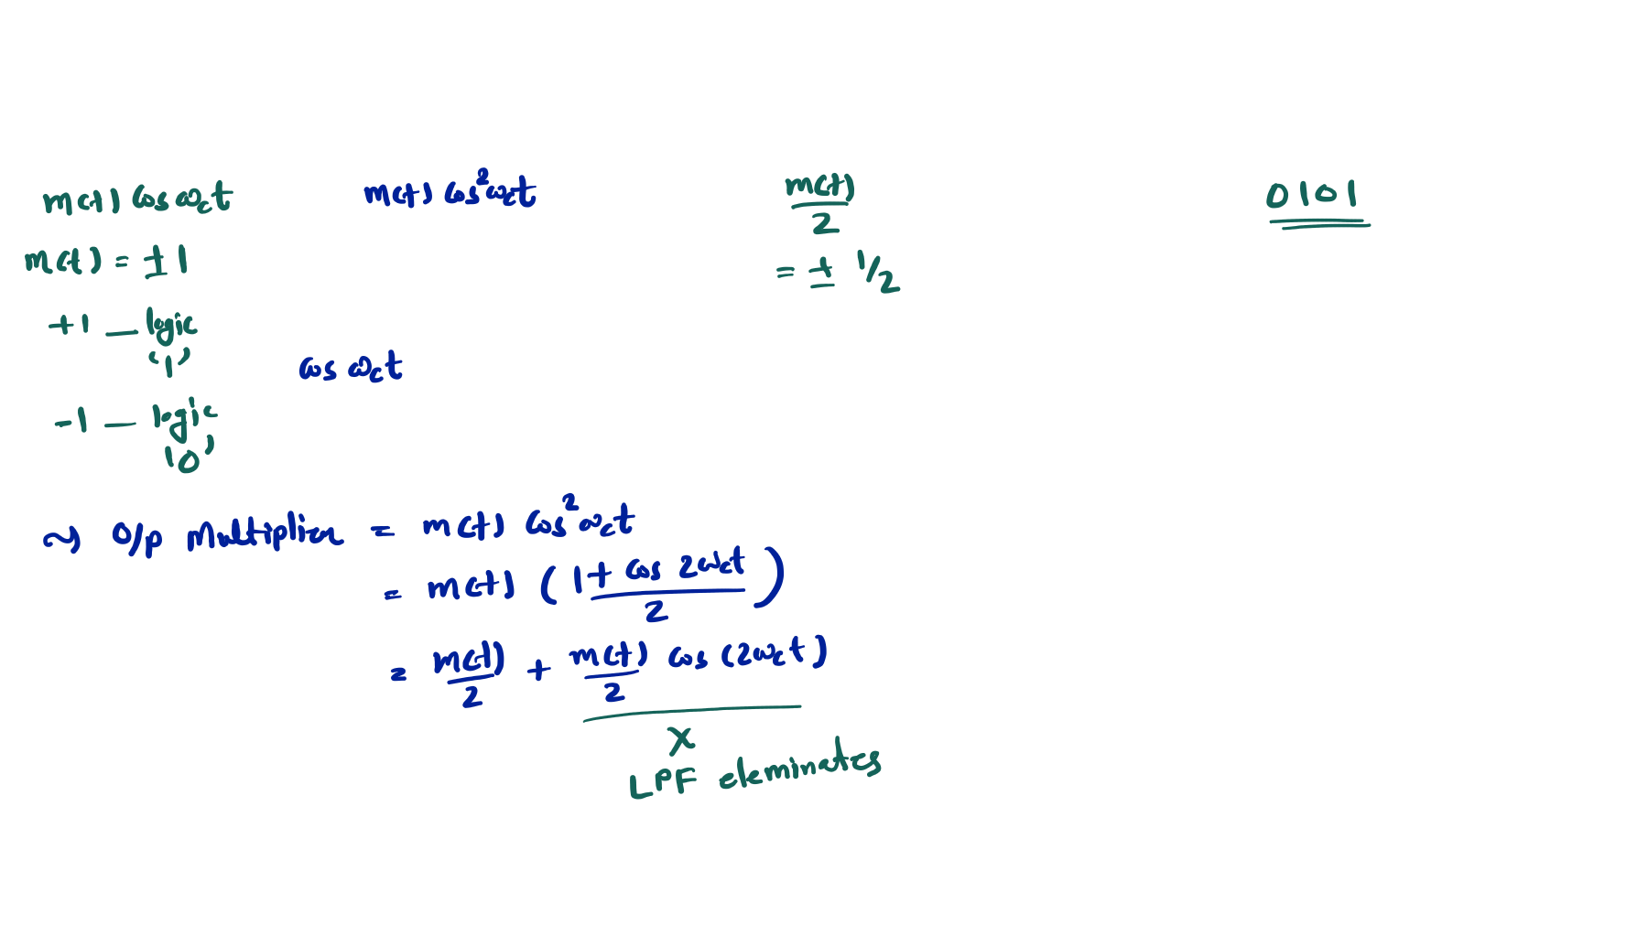



Demodulation of PSK
BPSK Signal
LPF
Message Signal
Comparator
Digital Data
Carrier Signal

Slide 35








Constellation Diagram of PSK
Q
Q
010 = Phase 90
011 = Phase 135
001 = Phase 45
I
I
Symbol for Logic 0
Phase 180
Symbol for Logic 1 Phase 0
100 = Phase 180
000 = Phase 0
101 = Phase 225 111 = Phase 315
110 = Phase 270
Binary PSK
8-PSK

Slide 36
Advantages of PSK
Better Power Efficiency
Better Bandwidth Efficiency
Constant Envelope
Disadvantages of PSK
Phase synchronisation is required.
Sensitive to Phase Noise and Doppler.
Higher Noise with Multipath Fading.
Envelope detection is not possible.
Applications of PSK
Wi-Fi {Uses BPSK and QPSK}
Cellular {LTE/5G uses QPSK}
Satellite {DVB-S2 uses 8-PSK}
Short Range and IoT

Slide 37
Differential Phase Shift Keying DPSK
Outlines
Basics of DPSK
DPSK Transmitter
DPSK Waveforms
DPSK Receiver
Advantages of DPSK
Disadvantages of DPSK
Applications of DPSK

Slide 38
Basics of DPSK
DPSK (Differential Phase Shift Keying) is a type of Phase Shift Keying (PSK) modulation.
Unlike standard PSK, DPSK encodes data based on the phase difference between successive bits instead of the absolute phase.
Non-coherent detection of PSK is difficult.
Non-coherent detection of DPSK reduces the cost of the circuits.

Slide 39
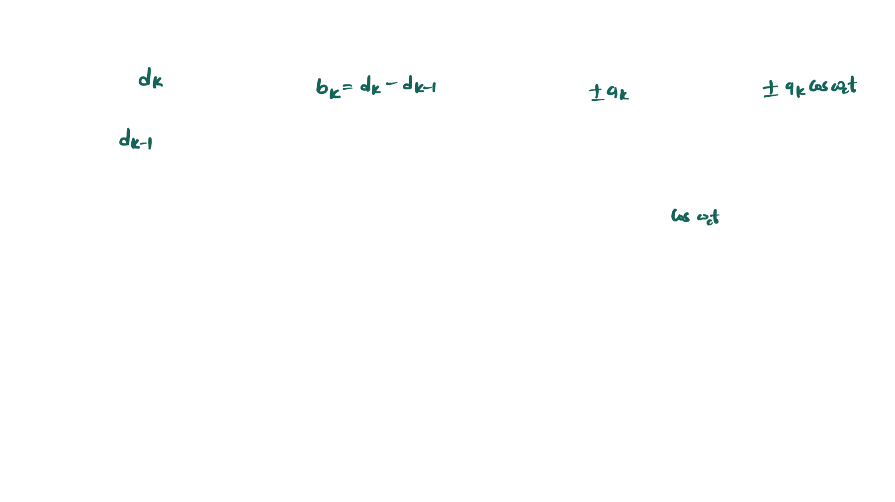




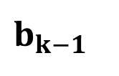
DPSK Transmitter
Bipolar NRZ
Encoder
Binary Signal
$$b_{k−1}$$
DPSK Signal
Delay Tb
Carrier Signal
DPSK Transmitter is similar to a PSK Transmitter.
Here, the binary signal is XORed with its
XOR Gate
Input 1 | Input 2 | Output
0 | 0 | 0
0 | 1 | 1
1 | 0 | 1
1 | 1 | 0
one-bit delayed Output version before being applied to the PSK modulator.

Slide 40
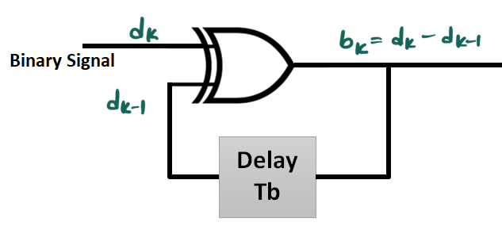
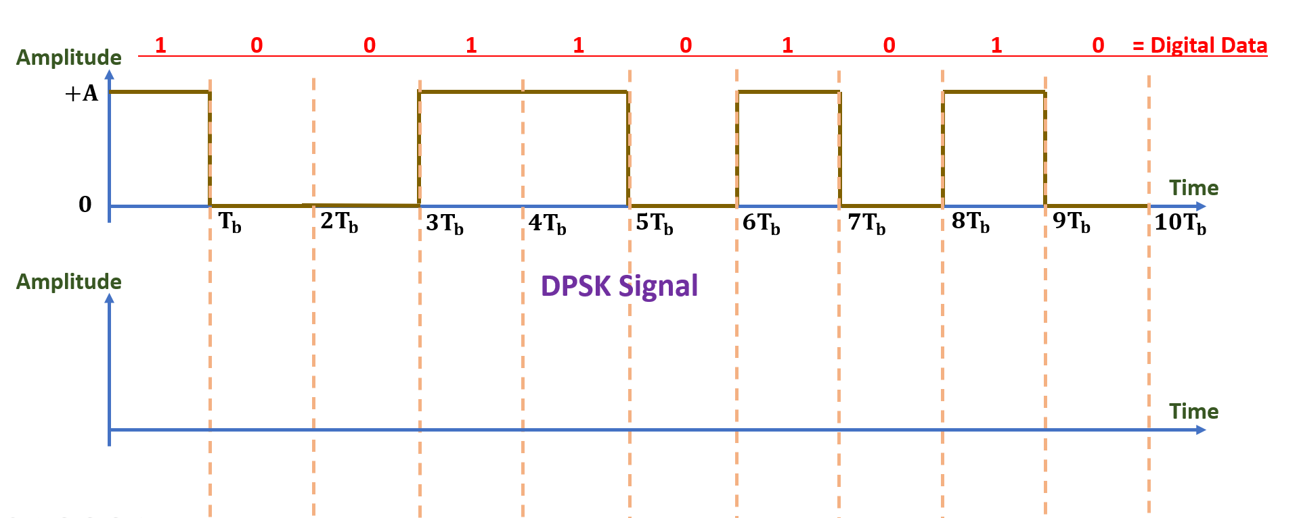
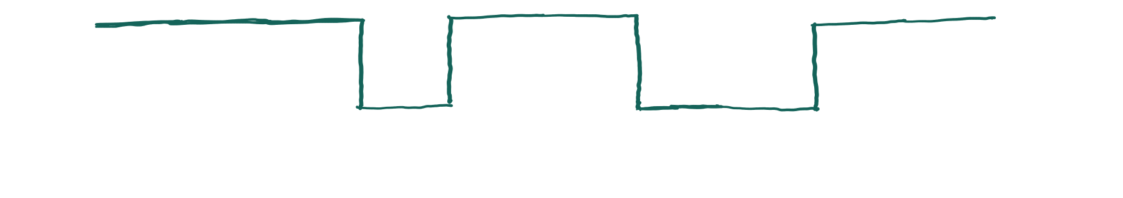

DPSK waveforms
First Input bit = First Output bit.
If the next input bit is logic “1”, then change the polarity of Output.
If the next input bit is logic “0”, then do not change the polarity of Output.
_{Amplitude} 1 0 0 1 1 0 1 0 1 0 = Digital Data
+𝐀
_{𝟎} Time
𝐓𝐛 𝟐𝐓𝐛 𝟑𝐓_{𝐛} 𝟒𝐓_{𝐛} 𝟓𝐓_{𝐛} 𝟔𝐓_{𝐛} 𝟕𝐓_{𝐛} 𝟖𝐓𝐛 𝟗𝐓𝐛 𝟏𝟎𝐓_{𝐛}
^{Amplitude} DPSK Signal
Time
$$b_{k}$$

Slide 41




DPSK Receiver
DPSK
Message
Signal
Digital Data
Signal
BPF
LPF
Comparator
Delay Tb
Logic ‘0’

Slide 42

Logic ‘1’

Slide 43
Advantages of DPSK
No Need for a Coherent Reference Carrier
More robust to Phase Noise compared to Standard PSK
Better Synchronisation Properties
Disadvantages of DPSK
Poor Performance compared to Standard PSK
Error Propagation {if one bit is wrongly detected, the next bit may also be affected}
More susceptible to Noise and Interference
Applications of DPSK
Wireless LAN and Bluetooth
Optical Communication
Satellite and Space Communication {Here, Coherent detection is difficult}
Short Range RF Systems

Slide 44

BPSK {Singal Space Diagram}

Slide 45


Slide 46



Slide 47


BPSK {Constellation Diagram or Signal Space Diagram}

Slide 48


BPSK Transmitter
Bipolar
_{NRZ} Product
Binary Data _{Encoder} ^{Modulator} 𝚽_{𝐁𝐏𝐒𝐊}
Carrier Generator

Slide 49
BASK Vs BFSK Vs BPSK
Parameters | BASK | BFSK | BPSK
Modulation Characteristics | Carrier Amplitude Varied | Carrier Frequency Varied | Carrier Phase Varied
Bandwidth (Min) | 2Fb [Fb is the BW of baseband signal] | 4Fb | 2Fb
Noise Immunity | Low | High | Moderate / High
Error Probability | High | Low | ❖ Moderate / Low
Complexity | Simple | Moderate | High
Bit rate | Suitable for Low Bitrate | Suitable for Moderate Bitrate | Suitable for High Bitrate
Detection | Envelope | Envelope / Coherent | Coherent
Power Efficiency | Poor | Moderate | Excellent
Synchronization | Low Requirement | Moderate Requirement | High Requirement
Phase Ambiguities | None | None | Possible
Latency | Low | Moderate | High
Applications | RFID & Short Range | Modems & Low Data rate | Wi-Fi, Satellite and Long Range
Moderate / High

